Slide 1
Project Title
Fitness Center Management System
Group - 03
Name | ID
Sadik Munha | 1931437042
Md. Rakibul Hasan | 1912435042
Sakib Reza | 1911525042
Mahabube Alahi Atik | 2012109642

Slide 2
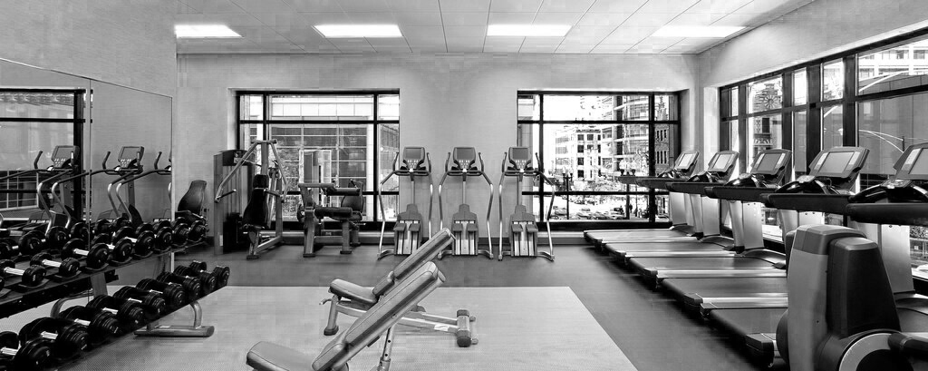
Introduction Our project is basically for them who run the fitness center. Those who will operate the software, first they will get information of gyms in a certain area and be able to add or update the information of all the members of their center and calculate their income and expenditure etc. and sell exercise equipment through this one software. On the other hand, users can buy exercise equipment at home and users can become a member of that organization by purchasing a membership package and as a result they will get some special benefits.

Slide 3


Our Target Audience Our main audience are health conscious men, women and children of all ages who like to change their lifestyle. They can schedule any time for workout at their convenience. Just as they can buy products at home and they can also subscribe membership at home.

Slide 4

Why we need this Application ?
Gym members and officials can access the system from anywhere with an internet connection, making it easier to manage the gym and access information.
This automates many manual tasks associated with managing a gym, such as membership management, scheduling, and billing. This saves time and reduces the risk of errors.
Often regular gym usage is not possible to work. The online gym contains a lot of body-weight exercises which can be completed at home.
However, the gym members will get special discounts on the same equipment’s and products. Moreover, certain facilities like personal trainer, buy membership online, discount offer etc. will be available for the members only.
On the other hand, those who run a fitness center used to need two different software’s. One is to manage their gym data and the other is if they were selling any product. But now they can do these two things together through a software and at the same time can register for membership online at home.

Slide 5

Function & Specialty
For User –
View and search all the available gyms in an area
Buy Equipment / Product
Buy Membership Package
Set Own Workout Planning
Assigning Trainer Personally
Update their full account
For Admin –
Admin can manage the whole system
Set up profile with different details
Add members detail to his database
Upload Products
Can send notice
Manage trainer

Slide 6
Thank you

